Slide 1
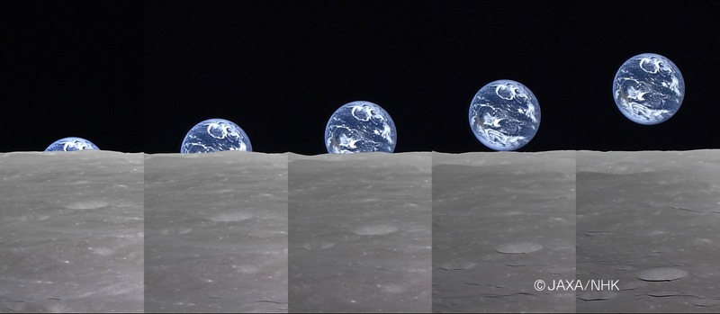
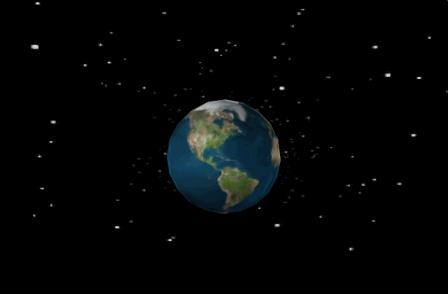
Google Earth Tips and Tricks
http://www.jaxa.jp/press/2008/04/20080411_kaguya_e.html
Dr. Peter Wampler

Slide 2
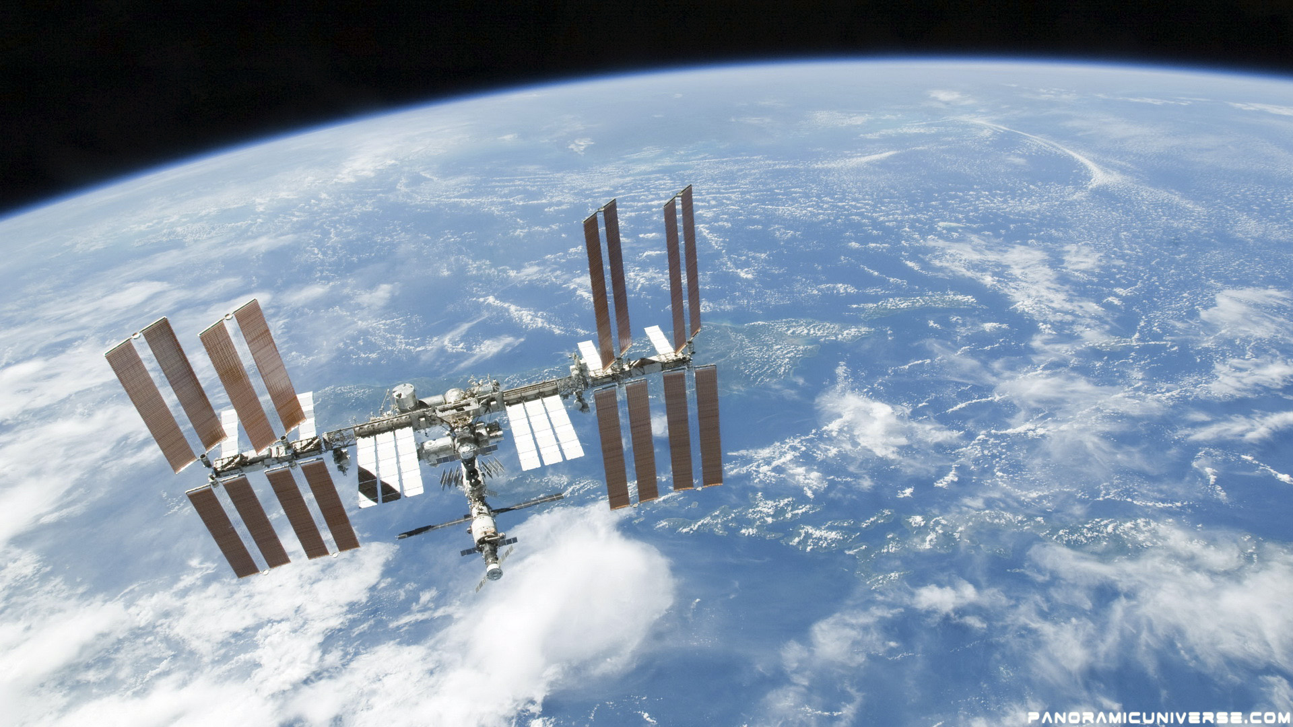
Outline
What is Google Earth?
Getting around the Globe with Google Earth
Pushpins and Scavenger Hunts
Some cool layers that are included
Travels through space and time
Other Planets!
Street View and Taking Virtual Walks
Putting Google Earth into your Presentations
Measurements and data collecting in Google

Slide 3
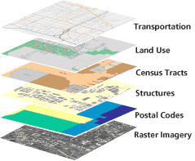
What is Google Earth?
GIS
(Geographic Information System) on steroids
A map
A database
An encyclopedia
A video library
A filing cabinet
Yellow pages
A 3D model of the world

Slide 4
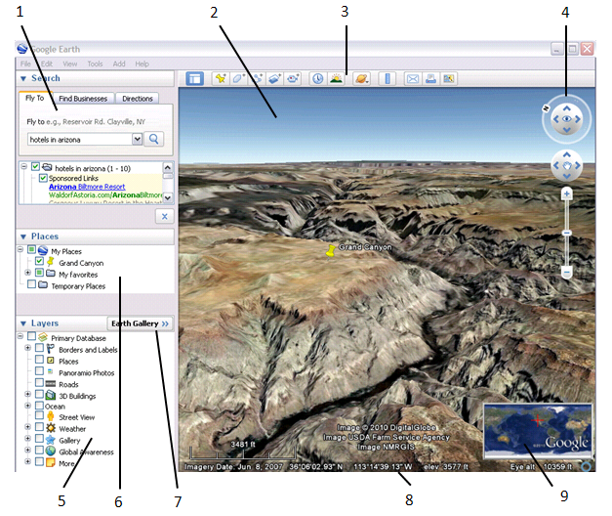
Anatomy of Google Earth
Search panel
3D Viewer
Toolbar buttons
Navigation controls
Layers panel
Places panel
Earth Gallery
Status bar
Overview map

Slide 5
Push Pins and Scavenger Hunts
Push pins to take students on virtual scavenger hunts and tours.
Push Pins can link to your photos, video, other people’s photos, graphs, etc.
Imagine a trail of notes with clues for finding the next point….
The icon for the pushpins can be anything even pictures.

Slide 6
Cool Layers that you can use
Recent Earthquakes – Curious about what is shaking around the globe? You can see recent earthquakes, their depth, and magnitude in real time.
Volcanoes – You can explore the globe and see where the volcanoes are located and in many cases pull up links that tell more about the specific volcanoes.
Youtube – Many videos are now linked to Google Earth so if you are trying to share with students about a particular geographic region or culture there may be video you can find based in their geographic location.
Gigapan Photos – These high resolution photos take you “on the ground at many locations”. Some are high enough resolution that you can identify people walking around on the ground.
Wikilocs – “Discover outdoor trails from all over the World, explore the paths on 3D terrain, download tracks for your GPS, enjoy the landscapes you'll see on the route by watching at the photos and Youtube videos taken along the trail by wikiloc.com users and pictures from Panoramio.”

Slide 7
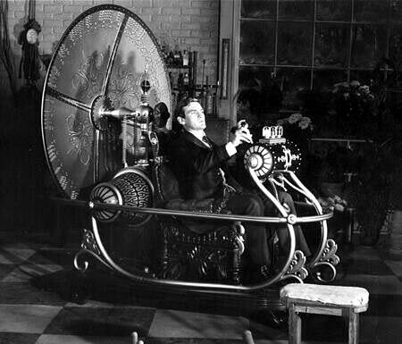
Time Travel
Starting in version 5.0 Google Earth allows you to view historical aerial photos of an area.
So we can use Google Earth to evaluate landscape changes.
For example measuring glacier retreat or river migration.
From The Time Machine (1960)
Let’s check out the changes in Grand Rapids

Slide 8
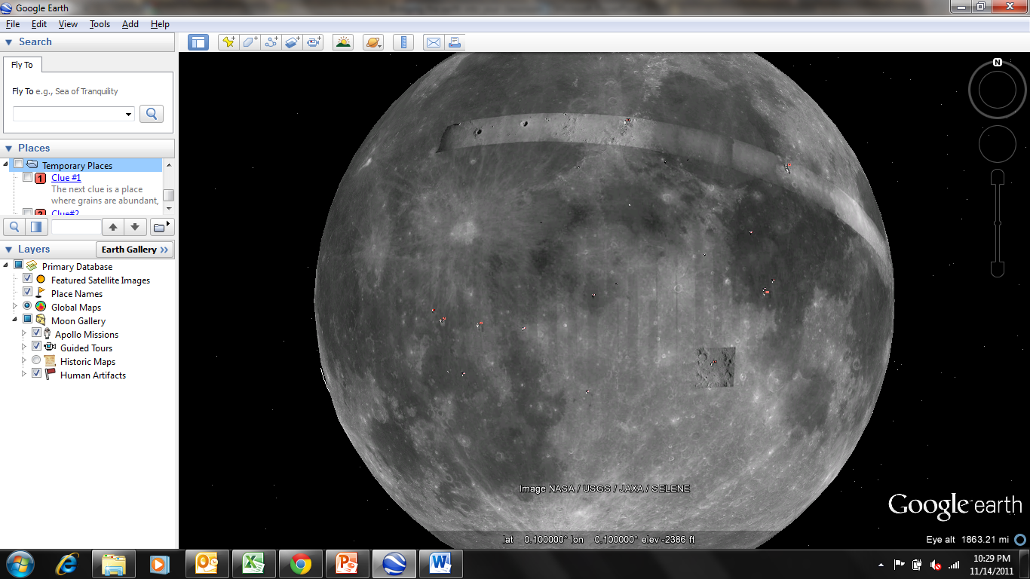
Other Planets in Google “Earth”

Slide 9
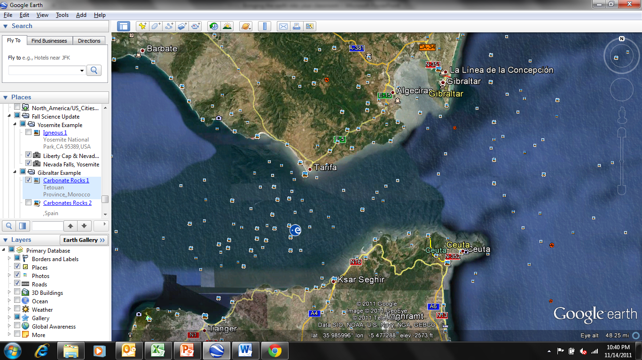
Street View and Virtual Field Trips
An example from the Straits of Gibraltar

Slide 10
Adding a Google Earth “Window” in your presentations

Slide 11
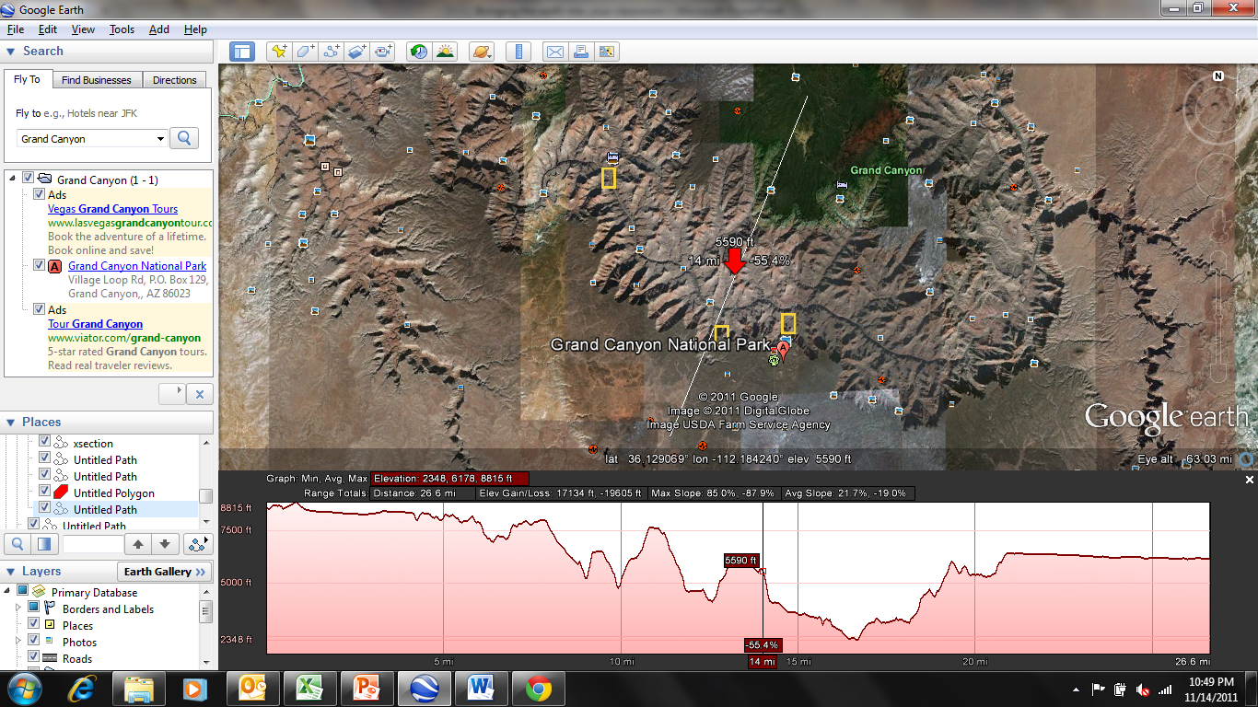
Measurements and Profiles

Slide 12
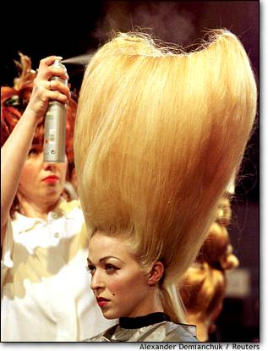
Questions?

